Slide 1
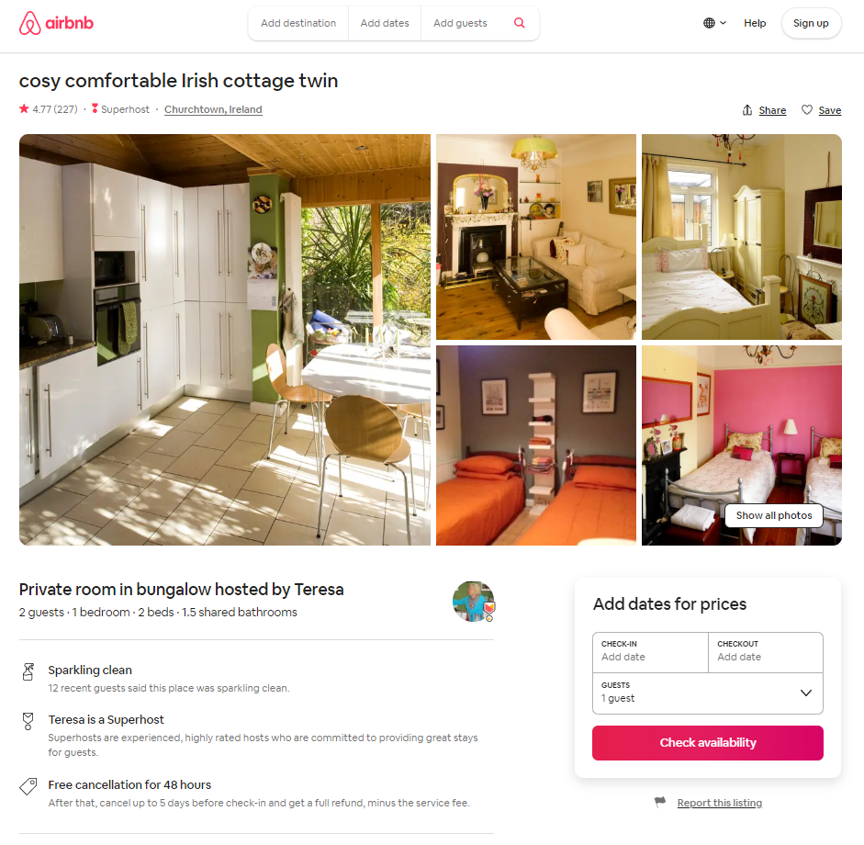
Data mining for listings
https://www.airbnb.ie/rooms/44077
Notes:
In the inside airbnb dataset, the csv file of listings contains the information of the room on the web page. There are 106 columns features. We divide these columns into text data and numeric data, they are processed in different ways.

Slide 2
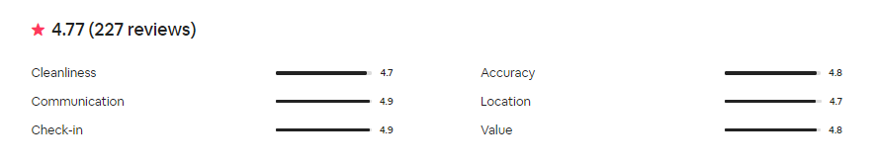
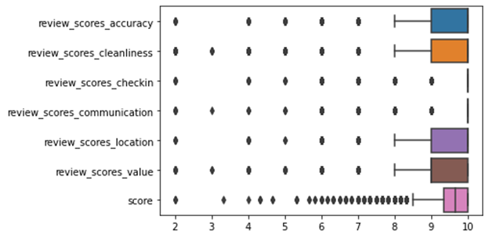
Notes:
This also contains the different review scores of the room. We divided the samples by median

Slide 3
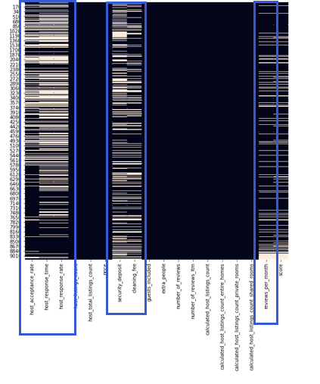
Columns with Missing Values
Discarded
host_acceptance_rate(21% missing)
host_response_time(35% missing)
Host_response_rate(35% missing)
reviews_per_month(91% correlate to review items)
Fillna with 0
Security_deposit
Cleaning_fee
Notes:
According to the heat map, there are 6 columns contains missing value. These missing values are missing not at random (MCAR).
the missing rate of the left 3 columns are more than 20%.
The ‘review per month’ has a high correlation (0.91) with ‘number of review item’, so these columns can be discarded.
‘cleaning fee’ and ‘security deposit’ has missing value because they are not on the webpage. So impute them with 0 is the suitable way.

Slide 4
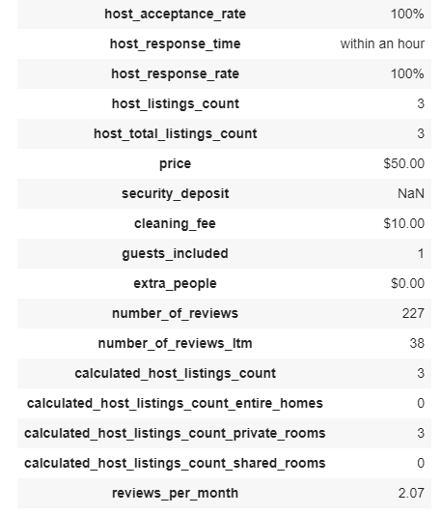
Preprocessing on Numeric Data on host page
Removal of the special symbol (‘%’ and ‘$’ in percentage and currency values)
Processing missing value
Standardize features by removing the mean and scaling to unit variance
Split dataset into random train and test subsets
Notes:
The next step is preprocessing on numeric data.
We removing of the special symbol in percentage and currency values.
And Standardize features with StandardScaler

Slide 5
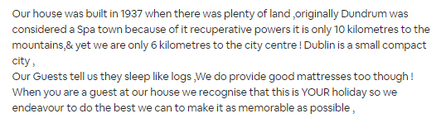
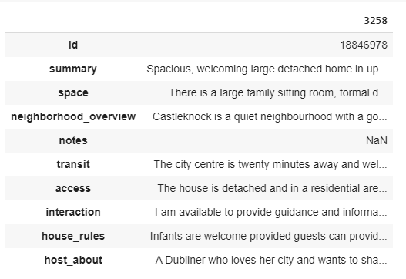
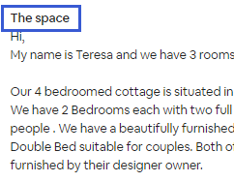
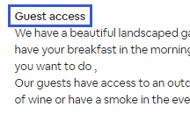
Text Preprocessing
Notes:
Before preprocessing on the text, We found that the names of these categories actually represent the sections of the article, so we put them together.

Slide 6
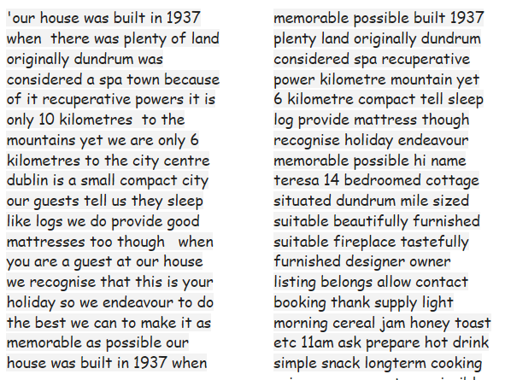
Preprocessing and Feature Engineering on Text
Preprocessing
Combine the nine parts
Lowercasing
Removal of Punctuation
Removal of StopWords
Removal of Unusual Characters
Removal of Common/Rare Words
Lemmatization
Notes:
The steps of preprocessing in our project includes lowercasing, removing punctuation , stop words rare and common words, and lemmatization

Slide 7
Features from Texts
Frequency-based Embedding
Count Vector
TF-IDF Vector
Word-Level
N-gram Level
Character N-gram Level
NLP-based Feature
Words Count
Characters Count
Average Word Length
Stop Words Count
Numerics Count
Noun Count
Verb Count
Adjective Count
Adverb Count
Pronoun Count
Sentiment Values
Vader Sentiment Intensity Analyzer
Negative Value
Neutral Value
Positive Value
Compound Value
Notes:
After preprocessing the text, we implement word embedding and NLP based methods to extract features from the text.
In addition, we also extract sentiment values from the text as features for each section of the article.

Slide 8
Modeling on Word Embedding Features
Naïve Bayes Classifier
MultinomialNB
ComplementNB
Logistic Regression
Support Vector Machine
Frequency based Embedding
Count Vector
TF-IDF Vector
Word-Level
N-gram Level
Character N-gram Level
Notes:
The next step is to use these features to train different classifiers. Since we chose four different types of word embedding methods and four different models, we get 16 different sets of results. We used the default parameters at begining, and then tuning the parameters using grid search cross validation

Slide 9
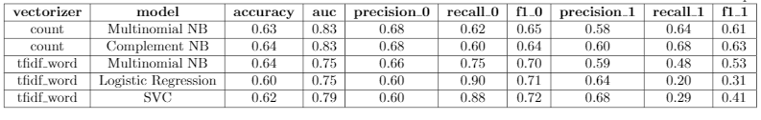
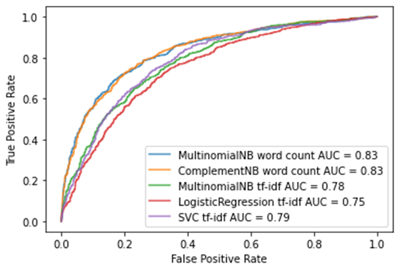
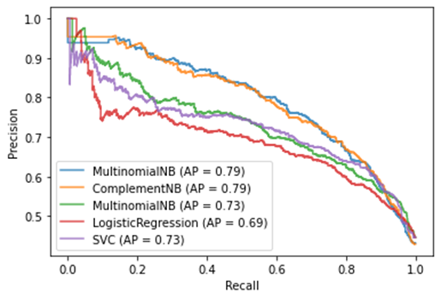
Evaluation after tuning hyperparameter
Notes:
According to the metrics and roc curve, Complement and Multinomial NB have better performance with wordcount vectors. According the recall value, logistic regression model with tf-idf vectors has good performense in detecting bad rooms.

Slide 10
Modeling on Numeric Features
NLP-based Features
Sentiment Values
Numeric Data on host page
KNeighborsClassifier
LogisticRegression
Support Vector Machine
Stochastic Gradient Descent
Random Forest Classifier
Notes:
Then we used the NLP based features, the sentiment value and the numeric data on host page to train the models.
The training and optimization process are similar as the word embedding features.

Slide 11
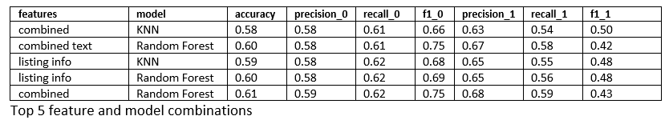
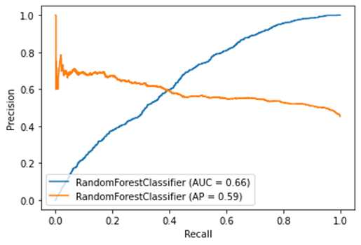
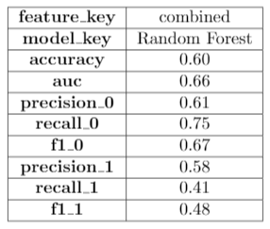
Evaluation on Numeric Features
After tuning hyperparameter
Notes:
The following table is the metrics of the optimized model. According to the results of it, classification performance by using these features is not as good as the word embedding features.

Slide 12
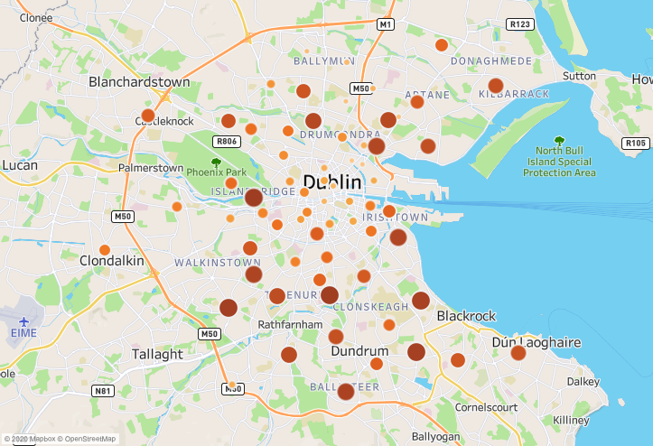
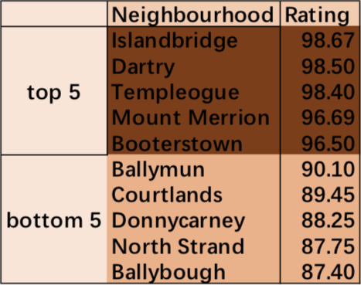
Rating distribution by neighbourhood
Tool: Tableau

Slide 13
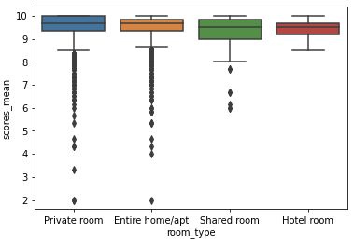
Rating comparison by room types

Slide 14
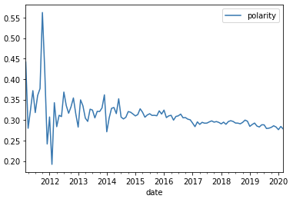

Rating seasonality
Polarity vs Month

